Slide 1
HYBRID CLOUD SERVICE
Sprint 5 demo : Apr 12, 2016
-Akash Singh
-Jaison Babu
-Surekha Jadhwani
-Vignesh Shanmuganathan
Mentor: Xu(Simon) Chen

Slide 2
Project Overview
Goals
Develop an hybrid cloud model that allows application to support data processing in either private or public or both clouds with seamless data distribution.
Easy user configuration to identify sensitive and non-sensitive data.
Data segregation of live twitter feed using tagging mechanism that allows distribution of data between private and public cloud.
Performance benchmarking of data analysis jobs between private, public and hybrid cloud.

Slide 3
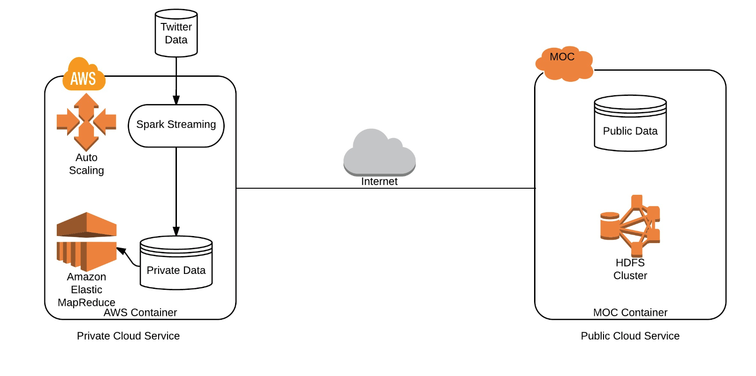
Cluster Configuration:
AWS Configuration :
MOC Configuration:
No of machines: 2
Ram: 1GB/machine
Storage: 15/machine
Sensitive Data: 4GB
No of machines: 5
Ram: 8GB/machine
Storage: 80GB/machine
Sensitive Data: 15GB

Slide 4
Where we are standing?
Progress = 100% goals achieved and ahead of plan + some stretch goals
achieved
Creating a public cloud in MOC that contains non-sensitive data.
Creating a private cloud in AWS that contains sensitive data.
Set-up of Hadoop clusters in AWS and MOC.
Establishing communication between AWS and MOC for data transfers.
A spark streaming service running on AWS will gather real time data from twitter and partition data according to user configuration for classifying data as sensitive/non-sensitive. The proposed data classifiers include hash tag mechanism and linguistics.
Based on the tags/linguistics, the created classifier will distribute data across AWS and MOC.
Running jobs in the following setups:
Running data analysis job on public cloud spanning the complete dataset (sensitive and non-sensitive data).
Running data analysis job on private cloud spanning the complete dataset.
Running data analysis job on non-sensitive data on public cloud and on sensitive data on private cloud, in parallel.
Performing benchmark analysis on the above proposed configurations.
Auto-scaling of data ( Stretch Goal)

Slide 5
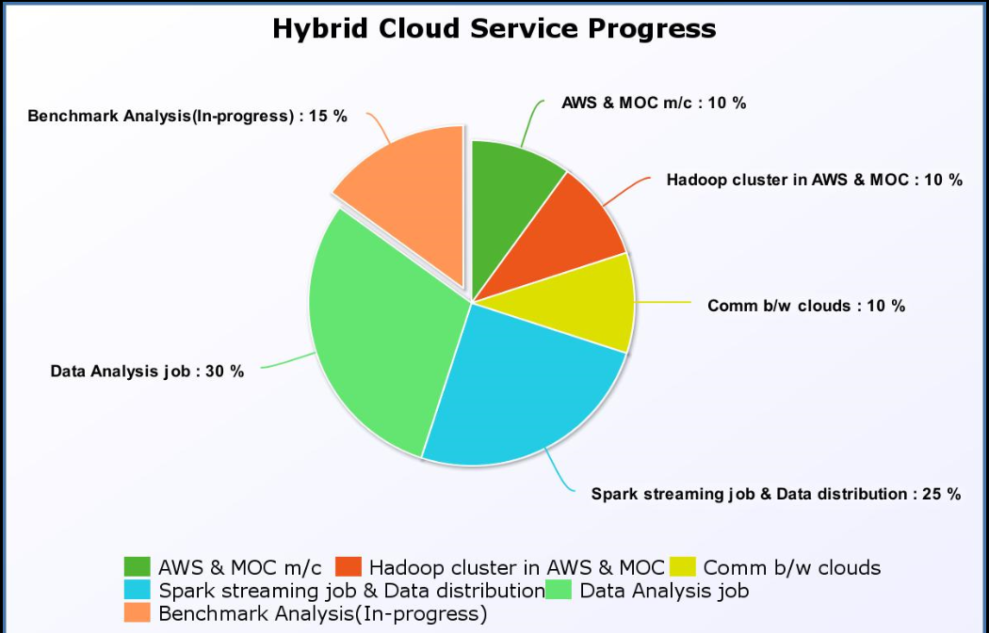
Where we are standing?(cont’d):

Slide 6
Major Innovations and Learnings:
Auto-scaling of data based upon user configuration.
Secured data transfer from private and public cloud.
Using MapReduce to write complex analytical job.
Understanding and using recursive folder structure to implement auto-scaling as well as running a MapReduce job.

Slide 7
Sprint 5 : Apr 12
User story covered:
As a user , one must be able to run spark analytical job both on Spark Hadoop AWS and MOC Cluster with performance enhancements
Explore use cases for parallel processing of Hadoop Analytic jobs in MOC and AWS
Implement use cases for parallel processing of Hadoop Analytic jobs in MOC and AWS
Create benchmarking harness
Perform analysis of analytical jobs on both private and public cloud
Auto-scaling for storage of streaming data.

Slide 8
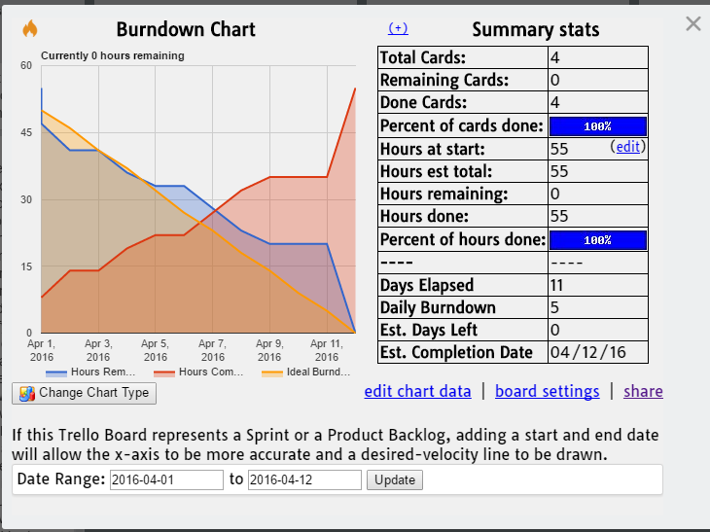
Trello Burndown:

Slide 9
Plan for Sprint 6: Apr 28
User story planned:
As a user , one must be able to access existing hybrid cloud implementation documents:
Document the Hybrid cloud service implementation.
Auto-scaling and complex MR analytical jobs (cont’d).
Code clean up.

Slide 10
DEMO: https://youtu.be/XLjRdbHaVxs

Slide 11
Questions?

Slide 12
Thank You

